Slide 1
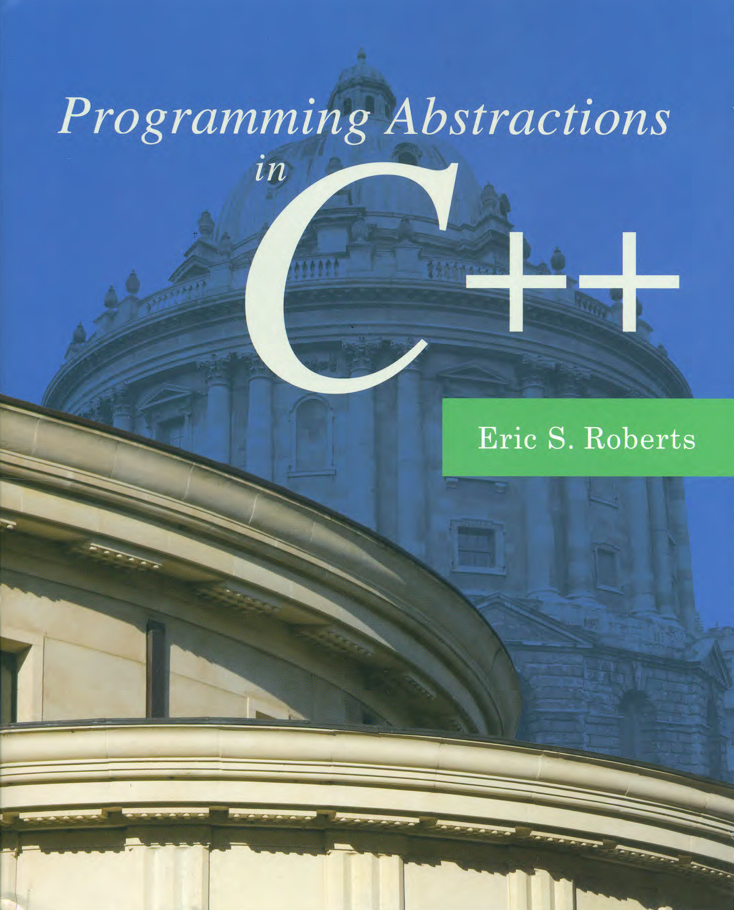
Dynamic Memory Management
C H A P T E R 12
You have burdened your memory with exploded systems and useless names.
—Mary Shelley, Frankenstein, 1818
12.1 Dynamic allocation and the heap
12.2 Linked lists
12.3 Freeing memory
12.4 Heap-stack diagrams
12.5 Defining a CharStack class
12.6 Efficiency of the CharStack class
12.7 Copying objects
12.8 The uses of const
12.9 Unit testing

Slide 2
Pointers
In C++, pointers serve several purposes, of which the following are the most important:
Pointers allow you to refer to a large data structure in a compact way. Because a memory address typically fits in a few bytes of memory, this strategy offers considerable space savings when the data structures themselves are large. E.g., call by pointers.
Pointers make it possible to reserve new memory during program execution. In many applications, it is convenient to acquire new memory as the program runs and to refer to that memory using pointers, which is called dynamic allocation.
Pointers can be used to record relationships among data items. Data structures that use pointers to create connections between individual components are called linked structures. Programmers can indicate that one data item follows another in a conceptual sequence by including a pointer to the second item in the internal representation of the first.

Slide 3
The Allocation of Memory to Variables
Flashback
When you declare a variable in a program, C++ allocates space for that variable from one of several memory regions.
One region of memory is reserved for variables that persist throughout the lifetime of the program, such as constants. This information is called static data.
Each time you call a method, C++ allocates a new block of memory called a stack frame to hold its local variables. These stack frames come from a region of memory called the stack.
It is also possible to allocate memory dynamically, as we will describe in Chapter 12. This space comes from a pool of memory called the heap.
In classical architectures, the stack and heap grow toward each other to maximize the available space.
static
data
0000
heap
stack
FFFF

Slide 4
Dynamic Allocation
C++ uses the new operator to allocate memory on the heap.
You can allocate a single value (as opposed to an array) by writing new followed by the type name. Thus, to allocate space for a int on the heap, you would write:
You can allocate an array of values using the following form:
Thus, to allocate an array of 10000 integers, you would write:
The delete operator frees memory previously allocated. For arrays, you need to include empty brackets, as in:
int* ip = new int;
new type[size]
int* array = new int[10000];
delete ip;
delete [] array;

Slide 5
Exercise: Dynamic Arrays
Write a method createIndexArray(n) that returns an integer array of size n in which each element is initialized to its index. As an example, calling
should result in the following configuration:
How would you free the memory allocated by this call?
int* digits = createIndexArray(10);
digits
0
1
2
3
4
5
6
7
8
9
0
1
2
3
4
5
6
7
8
9

Slide 6
Exercise: Dynamic Arrays
/*
* Function: createIndexArray
* Usage: int *array = createIndexArray(n);
* ----------------------------------------
* Returns a new dynamic integer array of length n
* in which every element is set to its own index.
*/
int* createIndexArray(int n) {
int* array = new int[n];
for (int i = 0; i < n; i++) {
array[i] = i;
}
return array;
}
int main() {
int *digits = createIndexArray(10);
delete [] digits;
}

Slide 7
Allocating a Point Object
The usual way to allocate a Point object is to declare it as a local variable on the stack, as follows:
It is, however, also possible to allocate a Point object on the heap using the following code:
Point pt(3, 4);
pt
FFF4
3
FFF8
4
FFFC
Point* pp = new Point(5, 12);
pp
5
pp
1000
5
FFF8
1000
12
1004
12
FFFC

Slide 8
Pointers
In C++, pointers serve several purposes, of which the following are the most important:
Pointers allow you to refer to a large data structure in a compact way. Because a memory address typically fits in a few bytes of memory, this strategy offers considerable space savings when the data structures themselves are large. E.g., call by pointers.
Pointers make it possible to reserve new memory during program execution. In many applications, it is convenient to acquire new memory as the program runs and to refer to that memory using pointers, which is called dynamic allocation.
Pointers can be used to record relationships among data items. Data structures that use pointers to create connections between individual components are called linked structures. Programmers can indicate that one data item follows another in a conceptual sequence by including a pointer to the second item in the internal representation of the first.

Slide 9
Linking Objects Together
Pointers are important in programming because they make it possible to represent the relationship among objects by linking them together in various ways.
The simplest example of a linked structure (which appears first in this chapter and is used throughout the later chapters) is called a linked list, in which each object in a sequence contains a reference to the one that follows it:
C++ marks the end of linked list using the constant NULL, which signifies a pointer that does not have an actual target.
In diagrams, the NULL value marking the end of a list is often indicated by drawing a diagonal line across the box.
data
data
data
data
NULL

Slide 10


The Beacons of Gondor
For answer Gandalf cried aloud to his horse. “On, Shadowfax! We must hasten. Time is short. See! The beacons of Gondor are alight, calling for aid. War is kindled. See, there is the fire on Amon Dîn, and flame on Eilenach; and there they go speeding west: Nardol, Erelas, Min-Rimmon, Calenhad, and the Halifirien on the borders of Rohan.”
—J. R. R. Tolkien, The Return of the King, 1955
In a scene that was brilliantly captured in Peter Jackson’s film adaptation of The Return of the King, Rohan is alerted to the danger to Gondor by a succession of signal fires moving from mountain top to mountain top. This scene is a perfect illustration of the idea of message passing in a linked list.
Minas Tirith
Amon Dîn
Eilenach
Nardol
Erelas
Min-Rimmon
Calenhad
Halifirien
Rohan

Slide 11
Message Passing in Linked Structures
To represent this message-passing image, you might use a definition such as the one shown on the right.
struct Tower {
string name; /* The name of this tower */
Tower *link; /* Pointer to the next tower */
};
/*
* Function: createTower(name, link);
* ----------------------------------
* Creates a new Tower with the specified values.
*/
Tower *createTower(string name, Tower *link) {
Tower *tp = new Tower;
tp->name = name;
tp->link = link;
return tp;
}
/*
* Function: signal(start);
* ------------------------
* Generates a signal beginning at start.
*/
void signal(Tower *start) {
if (start != NULL) {
cout << "Lighting " << start->name << endl;
signal(start->link);
}
}
You can then initialize a chain of Tower structures, like this:
Minas Tirith
Min-Rimmon
Amon Dîn
Calenhad
Eilenach
Halifirien
Nardol
Rohan
Erelas
Calling signal on the first tower sends a message down the chain.
Notes:
The order of creating towers is important.

Slide 12
Memory Management
The big challenge in working with dynamic allocation is freeing the heap memory you allocate. Programs that fail to do so have what computer scientists call memory leaks.
In Python and Java, objects are created on the heap and are automatically reclaimed by a garbage collector when those objects are no longer accessible. This discipline makes memory management very easy and convenient.
In C++, the situation is different for the following reasons:
Objects can be allocated either on the stack or in the heap.
C++ has no garbage collector, which means that programmers must manage memory allocation explicitly.
Fortunately, the designers of C++ made it possible to free memory allocated by objects when those objects go out of scope on the stack. . .

Slide 13
Garbage collection
Advantages: Garbage collection frees the programmer from manually dealing with memory deallocation. As a result, certain categories of bugs are eliminated or substantially reduced:
Certain kinds of memory leaks
Dangling pointer bugs
Double free bugs
Efficient implementations of persistent data structures
Disadvantages
Consuming additional resources
Performance impacts
Possible stalls in program execution
Incompatibility with manual resource management
char *p1 = new char;
char *p2 = new char;
p2 = p1;
delete p1;
delete p2;

Slide 14
Destructors
In C++, class definitions often include a destructor, which specifies how to free the storage used to represent an instance of that class.
The prototype for a destructor has no return type and uses the name of the class preceded by a tilde (~). The destructor must not take any arguments.
C++ calls the destructor automatically whenever a variable of a particular class is released. For stack objects, this happens when the function returns. The effect of this rule is that a C++ program that declares its objects as local variables on the stack will automatically reclaim those variables.
If you instead allocate space for an object in the heap using new, you must explicitly free that object by calling delete. Calling delete automatically invokes the destructor.

Slide 15
Heap-Stack Diagrams
It is easier to understand how C++ works if you have a good mental model of its use of memory. I find the most useful model is a heap-stack diagram, which shows the heap on the left and the stack on the right, separated by a dotted line.
Whenever your program uses new, you need to add a block of memory to the heap side of the diagram. That block must be large enough to store the entire value you’re allocating. If the value is a struct or an object type, that block must include space for all the members inside that structure.
Whenever your program calls a method, you need to create a new stack frame by adding a block of memory to the stack side. For method calls, you need to add enough space to store the local variables for the method, again with some overhead information that tracks what the program is doing. When a method returns, C++ reclaims the memory in its frame.

Slide 16
Exercise: Heap-Stack Diagrams
int main() {
Point pt;
double total = 0.0;
pt.x = 1;
pt.y = 2;
int *array = new int[5];
nonsense(array, pt, total);
return 0;
}
void nonsense(int list[], Point pt, double & total) {
Point *pptr = new Point;
list[1] = pt.x;
total += pt.y;
}
stack
heap
stack
???
1000
list
1000
FFD0
1
1004
???
pt
1
FFD4
???
1008
2
FFD8
???
100C
total &
FFF4
FFDC
???
1010
pptr
???
FFE0
1014
???
1014
FFE4
???
1018
array
1000
FFE8
???
pt
1
FFEC
???
2
FFF0
???
total
0.0
FFF4
2.0
???
FFF8
FFFC

Slide 17
Example: The CharStack Class
Write classes that use dynamic allocation
CharStack: a stack of characters
CharStack cstk;
Initializes an empty stack.
cstk.size()
Returns the number of characters pushed onto the stack.
cstk.isEmpty()
Returns true if the stack is empty.
cstk.clear()
Deletes all characters from the stack.
cstk.push(ch)
Pushes a new character onto the stack.
cstk.pop()
Removes and returns the top character from the stack.

Slide 18
The charstack.h Interface
/*
* File: charstack.h
* -----------------
* This interface defines the CharStack class.
*/
#ifndef _charstack_h
#define _charstack_h
class CharStack {
public:
/*
* CharStack constructor and destructor
* ------------------------------------
* The constructor initializes an empty stack. The destructor
* is responsible for freeing heap storage.
*/
CharStack();
~CharStack();

Slide 19
The charstack.h Interface
/*
* Methods: size, isEmpty, clear, push, pop
* ----------------------------------------
* These methods work exactly as they do for the Stack class.
* The peek method is deleted here to save space.
*/
int size();
bool isEmpty();
void clear();
void push(char ch);
char pop();
#include "charstackpriv.h"
#endif
/*
* File: charstack.h
* -----------------
* This interface defines the CharStack class.
*/
#ifndef _charstack_h
#define _charstack_h
class CharStack {
public:
/*
* CharStack constructor and destructor
* ------------------------------------
* The constructor initializes an empty stack. The destructor
* is responsible for freeing heap storage.
*/
CharStack();
~CharStack();

Slide 20
The charstackpriv.h File
/*
* File: charstackpriv.h
* ---------------------
* This file contains the private data for the CharStack class.
*/
private:
/* Instance variables */
char *array; /* Dynamic array of characters */
int capacity; /* Allocated size of that array */
int count; /* Current count of chars pushed */
/* Private function prototypes */
void expandCapacity();

Slide 21
The charstack.cpp Implementation
/*
* File: charstack.cpp
* -------------------
* This file implements the CharStack class.
*/
#include "charstack.h"
#include "error.h"
using namespace std;
/*
* Constant: INITIAL_CAPACITY
* --------------------------
* This constant defines the initial allocated size of the dynamic
* array used to hold the elements. If the stack grows beyond its
* capacity, the implementation doubles the allocated size.
*/
const int INITIAL_CAPACITY = 10;

Slide 22
The charstack.cpp Implementation
/*
* Implementation notes: constructor and destructor
* ------------------------------------------------
* The constructor allocates dynamic array storage to hold the
* stack elements. The destructor must free these elements
*/
CharStack::CharStack() {
capacity = INITIAL_CAPACITY;
array = new char[capacity];
count = 0;
}
CharStack::~CharStack() {
delete[] array;
}
/*
* File: charstack.cpp
* -------------------
* This file implements the CharStack class.
*/
#include "charstack.h"
#include "error.h"
using namespace std;
/*
* Constant: INITIAL_CAPACITY
* --------------------------
* This constant defines the initial allocated size of the dynamic
* array used to hold the elements. If the stack grows beyond its
* capacity, the implementation doubles the allocated size.
*/
const int INITIAL_CAPACITY = 10;

Slide 23
The charstack.cpp Implementation
/*
* Implementation notes: constructor and destructor
* ------------------------------------------------
* The constructor allocates dynamic array storage to hold the
* stack elements. The destructor must free these elements
*/
CharStack::CharStack() {
capacity = INITIAL_CAPACITY;
array = new char[capacity];
count = 0;
}
CharStack::~CharStack() {
delete[] array;
}
int CharStack::size() {
return count;
}
bool CharStack::isEmpty() {
return count == 0;
}
void CharStack::clear() {
count = 0;
}
void CharStack::push(char ch) {
if (count == capacity) expandCapacity();
array[count++] = ch;
}
char CharStack::pop() {
if (isEmpty()) error("pop: Attempting to pop an empty stack");
return array[--count];
}

Slide 24
The charstack.cpp Implementation
int CharStack::size() {
return count;
}
bool CharStack::isEmpty() {
return count == 0;
}
void CharStack::clear() {
count = 0;
}
void CharStack::push(char ch) {
if (count == capacity) expandCapacity();
array[count++] = ch;
}
char CharStack::pop() {
if (isEmpty()) error("pop: Attempting to pop an empty stack");
return array[--count];
}
/*
* Implementation notes: expandCapacity
* ------------------------------------
* This private method doubles the capacity of the elements array
* whenever it runs out of space. To do so, it must copy the
* pointer to the old array, allocate a new array with twice the
* capacity, copy the characters from the old array to the new
* one, and finally free the old storage.
*/
void CharStack::expandCapacity() {
char *oldArray = array;
capacity *= 2;
array = new char[capacity];
for (int i = 0; i < count; i++) {
array[i] = oldArray[i];
}
delete[] oldArray;
}

Slide 25
Copying Objects
There is one remaining issue, from previous chapters, about creating new abstract classes that is extremely important in practice, which is how such objects behave if you copy them.
When you are defining a new abstract data type in C++, you typically need to define two methods to ensure that copies are handled correctly:
The operator operator=, which takes care of assignments
A copy constructor, which takes care of by-value parameters
These methods have well-defined signatures and structures, and the easiest thing to do is simply to copy the sample code on the next few slides, adapting it as necessary to account for the specific instance variables that need to be copied in the underlying representation.

Slide 26
Copying Objects
The process of copying an object is controlled by two standard methods, each of which has a specific prototype.
The assignment operator has the following form:
The prototype for the copy constructor looks like this:
const type & type::operator=(const type & rhs)
type::type(const type & rhs)

Slide 27
Assignment and Copy Constructors
The simplest strategy for ensuring that clients don’t violate the integrity of data structures through assignment is to prevent the client from copying an object altogether by making the assignment operator and copy constructor private methods.
For data structures such as the collection classes, however, this approach is too restrictive. The collection classes in C++ are defined so that copying one collection to another creates an entirely new copy of the collection.
Unfortunately, the default behavior of C++ is to copy only the top-level fields in an object, which means that all dynamically allocated memory is shared between the original and the copy. This default behavior, which is called shallow copying, violates the semantics of collections. What you need to implement instead is deep copying, which copies the data in the dynamically allocated memory as well.

Slide 28
Shallow vs. Deep Copying
Suppose that you have an existing Vector<int> with three elements as shown in the diagram to the right.
A shallow copy allocates new fields for the object itself and copies the information from the original. Unfortunately, the dynamic array is copied as an address, not the data.
A deep copy also copies the contents of the dynamic array and therefore creates two independent structures
10
1000
elements
1000
20
100
capacity
30
3
count
.
.
.
1000
elements
100
capacity
3
count
2000
10
2000
elements
20
100
capacity
30
3
count
.
.
.

Slide 29
Implementing Deep Copy Semantics
This becomes an issue especially when you implement a class that uses dynamic memory.
The crux of the problem is that copying an abstract data object typically needs to copy the underlying data (deep copying) and not just the fields directly accessible in the object.
Unfortunately, the default interpretation in C++ is to copy only the top-level fields (shallow copying), which can lead to serious errors if you are expecting deep copying.
Therefore, it is important to specify how the object can be properly copied in your implementation.

Slide 30
Code to Implement Deep Copying
/*
* Implementation notes: copy constructor and assignment operator
* --------------------------------------------------------------
* These methods make it possible to pass a CharStack by value or
* assign one CharStack to another.
*/
CharStack::CharStack(const CharStack & src) {
deepCopy(src);
}
CharStack & CharStack::operator=(const CharStack & src) {
if (this != &src) {
delete[] array;
deepCopy(src);
}
return *this;
}
void CharStack::deepCopy(const CharStack & src) {
array = new char[src.count];
for (int i = 0; i < src.count; i++) {
array[i] = src.array[i];
}
count = src.count;
capacity = src.capacity;
}
capacity

Slide 31
The Uses of const
The const keyword has many distinct purposes in C++. This text uses it in the following three contexts:
Constant definitions. Adding the keyword const to a variable definition tells the compiler to disallow subsequent assignments to that variable, thereby making it constant. const double PI = 3.14159265358979323846;
Constant call by reference. Adding const to the declaration of a reference parameter signifies that the function will not change the value of that parameter. This guarantee allows the compiler to share the contents of a data structure without allowing methods to change it. void deepCopy(const CharStack & src);
Constant methods. Adding const after the parameter list of a method guarantees that the method will not change the object. int CharStack::size() const
Classes that use the const specification for all appropriate parameters and methods are said to be const-correct.

Slide 32
Unit Testing
One of the most important responsibilities you have as a programmer is to test your code as thoroughly as you can. Although testing can never guarantee the absence of errors, adopting a deliberate testing methodology helps you to find at least some of the errors in your code.
Whenever you write a module, it is good practice to create a test program that checks the correctness of that module in isolation from the rest of the code. Such tests are called unit tests.
The text uses the assert macro from the <cassert> library to implement the unit-testing strategy. If the conditional expression in the assert macro is true, execution continues normally. If the expression is false, the assert macro prints a message identifying the source of the error and exits from the program.

Slide 34
The End

